Slide 1
Statistics in Pharmaceutical Development and Manufacturing
Veroni Jayawardana
Senior Scientist, Merck & Co.
27th May 2022

Slide 2
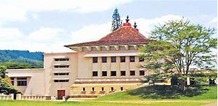
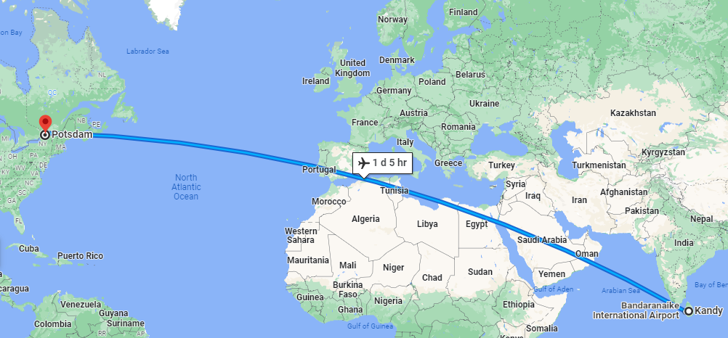
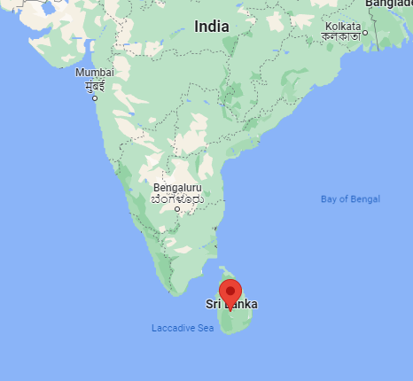
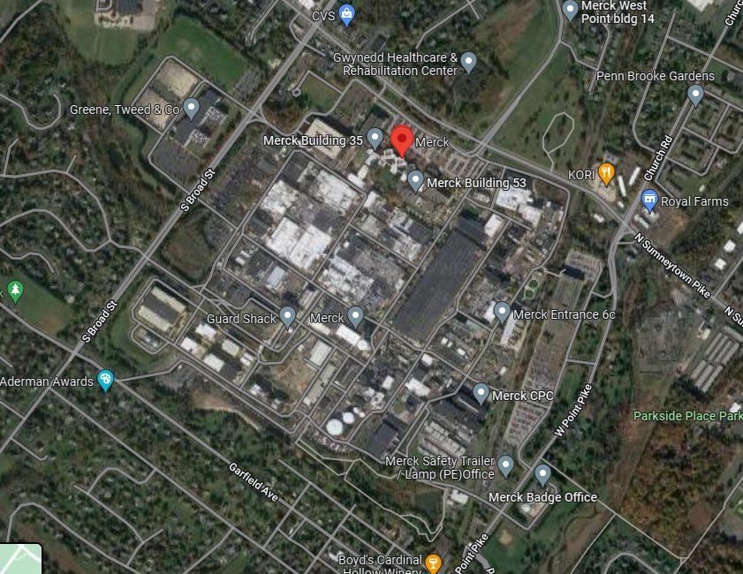
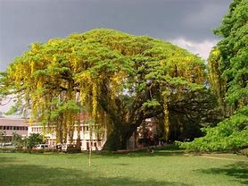
About me…

Slide 3
Outline
Classification of pharmaceutical products
Phases of pharmaceutical development and manufacturing process of a discovery
Analytical methods and statistical support employed in these phases
The role of statisticians in pharmaceutical development and manufacturing
Statistical software and information technology involved
Clarkson University (CU) courses and programs that helped me to shape my career

Slide 4
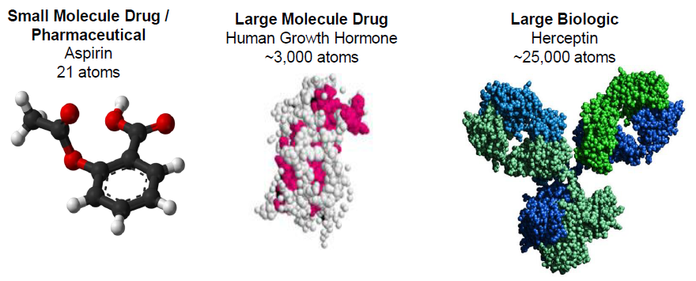
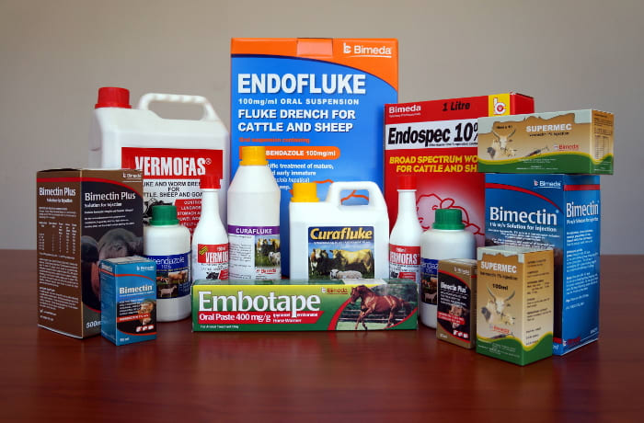
Classification of pharmaceutical products
Human Health
Animal Health
Pills and Capsules
Vaccines
Oncology Treatments

Slide 5
Schematic of pharmaceutical development and manufacturing processes
Clinical Trials:
Phase 1
Phase IIA
Phase IIB
Phase III
Phase IV
Pharmacology
Drug approved for marketing and manufacture
Pre-Clinical:
Product development phase
Animal Toxicology
Active Pharma Ingredient (API):
Small Scale Process
Process Scale-up
Technology Transfer
Full Scale Manufacture
Discovery
Small Scale Process
Process Scale-up
Technology Transfer
Full Scale Manufacture
Formulation:
Assay Development
Assay Validation
Method Transfer
Quality Control
Analytical:

Slide 6
Phases of development for API, drug product, and analytical methods
 | API | Drug product | Analytical methods
Pre-clinical Lab and animal studies | Molecule selection, synthetic route development, creation of supplies for animal testing | Animal studies | Determine measurement needs, select analytical methods, develop standards
Phase I Safety studies (20-100 volunteers) | Start GMP manufacturing process for clinical trial investigation of physical properties | Consider formulation, investigate supplies, stability requirements | Analytical-method optimization
Phase II Dose finding efficacy (100-500 volunteers) | Scaling up chemical synthesis | Drug-product formulation optimized, shelf-life studies begin | Analytical-method optimization
Phase III Confirm efficacy and safety (1000-5000 volunteers) | Clinical-trial supply manufacture, identification of critical process characteristics, process validation | Manufacture of clinical trial supplies, scale-up of drug product determination, process validation | Product and process specification finalized, process monitoring established
Phase IV FDA review/ ongoing studies | Technology transfer from R&D to commercial manufacturing facility | Technology transfer from R&D to commercial manufacture facility | Product and process monitoring for statistical control and quality improvement

Slide 7
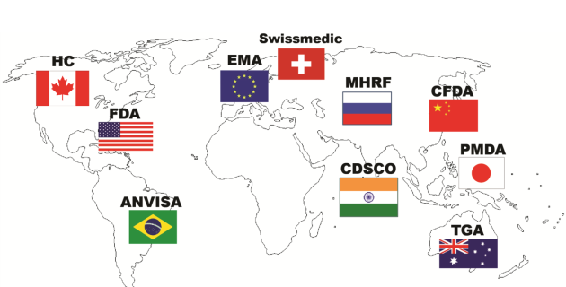
Regulatory agencies worldwide, standards, and regulations
USP – United States Pharmacopeia (standards to help to ensure the products are of appropriate identity, as well as strength, quality, purity and consistency)
ICH – International Conference on Harmonization (provides a unified standard for the European Union, Japan, and the US)

Slide 8
Drug product development and statistical support
Milestone | Activities | Statistical Support
Nominate an API for clinical development | Discover the API and perform various preclinical studies | Multiple comparison techniques for combinatorial chemists; analysis of genomic data; design and analysis of animal safety studies
Perform Phase I clinical studies | Determine Phase I dosage type Excipient compatibility studies Accelerated stability studies | Analysis of historical data; statistical thinking Design and analyze experiments Regression analysis
Perform Phase II dose ranging and proof of concept clinical studies | Determine Phase II dosage type Evaluate excipient compatibility Develop Phase II dosage formulation Develop Phase II manufacturing process Stability studies | Analysis of historical data; statistical thinking Design and analyze experiments Design and analyze factorial or mixture experiments Design and analyze factorial or response surface experiments Regression analysis
Perform Phase III clinical studies | Develop and scale Phase III dosage formulation Develop and scale Phase III manufacturing process Develop process analytical technology application Transfer technology to commercial manufacturing division | Design and analyze factorial or response surface experiments Design and analyze factorial or mixture experiments Multivariate analysis Write reports and consult
Submit new-drug application | Develop and scale commercial formulation and process Define design and knowledge spaces for DP formulation and process Conduct ICH campaign | Design and analyze factorial, mechanistic, mixture and response surface experiments Design and analyze product-and-process understanding experiments Analyze ICH stability studies (set expiry)
Produce commercial product | Establish quality attribute procedures Monitor drug product stability Improve the process | Assess process capability and establish quality systems to control the process Analyze data from annual stability lots Data mining, DoE, Six Sigma techniques, Lean techniques, JIT manufacturing

Slide 9
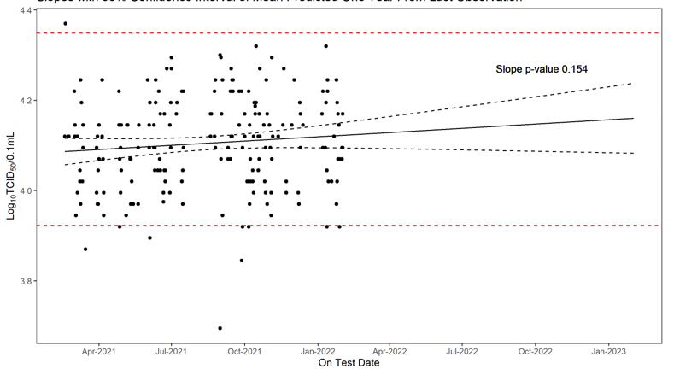
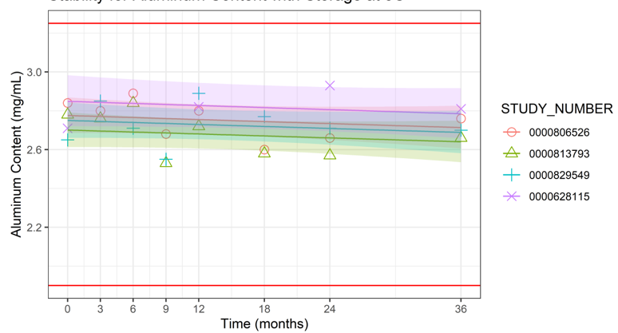
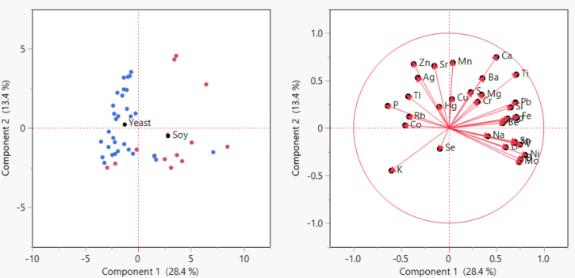
Statistical support during manufacturing process
Regressions
Linear Regression
Mixed Effect Models
Multivariate Regression
Extensions on current qualified products
Stability analysis and shelf-life calculation
Identify metals that drive the difference between good and bad lots

Slide 10
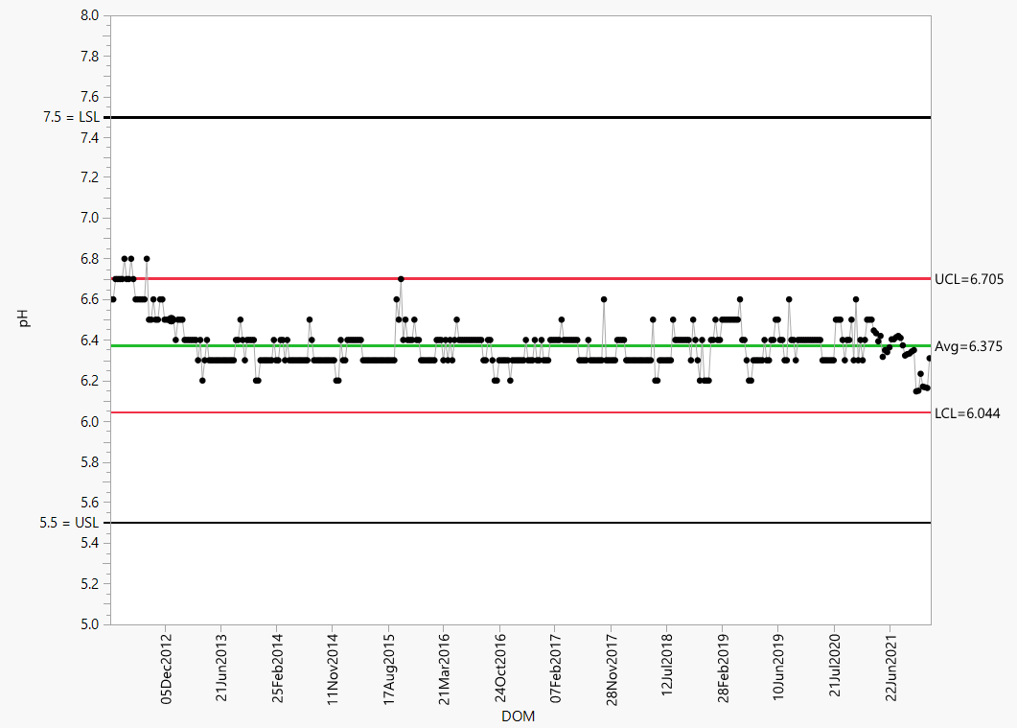
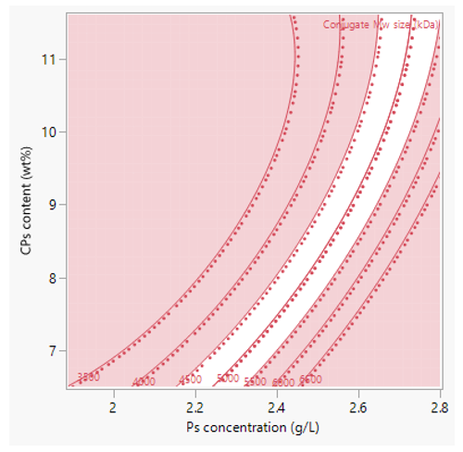
DOE
Statistical process control
Optimal designs
Response surface model
D-Optimal design
I-Optimal design
Estimate parameters using less experimental runs with the same precision as a non-optimal design
Calculating parameter estimates for the experiment
Control charts to monitor the assay is performing as expected

Slide 11
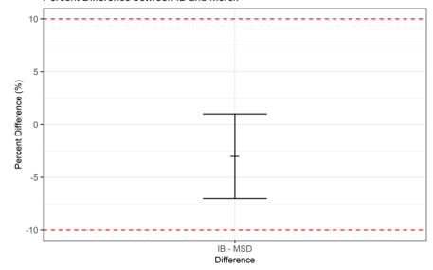
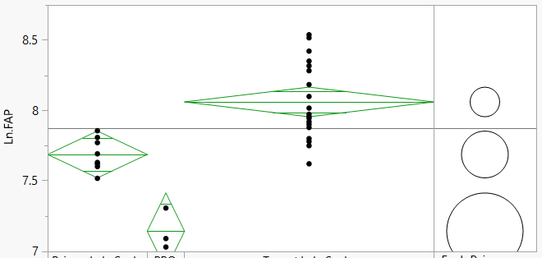
Equivalency
Multiple comparison
Performed during assay transfer
To qualify a new instrument
Differences between two scales
Differences with respect to a control group

Slide 12
Statisticians’ positions and statistical software
Clinical
Non-Clinical
Biostatisticians, Data Scientists, Development Statisticians, Statisticians
Statisticians, Data Scientists
Role
Biostatisticians: SAS, R
Data Scientists: R, Python, SQL
Development Statistician: SAS, R, Python
Statisticians: SAS, R, JMP, Minitab, Design Expert
Data Scientists: R, Python, SQL
Statistical Softwares

Slide 13
CU courses and programs that helped me to shape my career
Courses
Programs
Probability and Statistics (IA 530)
Advanced applied Statistics (STAT 584)
Biostatistics (STAT 318)
Probability and statistics (STAT 383)
Bayesian Data Analysis (STAT 585)
Ecological statistics
Design of Experiment/ Design Expert
Data analysis to support graduate/undergraduate students and CU faculty collaborative research
Teaching assistant and tutoring – Biostatistics, Applied and General Statistics, Probability, Calculus, and Linear Algebra
Career fair

Slide 14
Thank you for your attention!

